Slide 1
2022 Campaign
Worker Training
National Campaign Dates:
Sep 1, 2022 – January 14, 2023
Local Zone Campaign Dates:
Oct 3, 2022 – January 14, 2023
Notes:
Welcome to the 2022 Combined Federal Campaign, also known as the “CFC.” Thank you for attending today’s Campaign Worker Training. [Introduce yourself.] ​My name is XXX and my colleague XXX will be monitoring the chat.
Thank you for agreeing to serve as a CFC Campaign Manager, Coordinator or Keyworker. These roles are a professional development opportunity, as you will be the primary point of contact for CFC information and engagement within your agency/installation and leadership. You'll be increasing visibility of the campaign and positively impacting the charities supported through the CFC. It is individuals like you that have made this program what it is - So, thank you for taking on the role for your agency/installation! ​​
While the giving portal opens on Sept 1 for people to start making pledges, our campaign will be kicking-off on Monday 3 OCT. The campaign will run through 14 January, when the giving portal will close, and no more pledges can be made.

Slide 2
Virtual etiquette
Please keep your device on mute.
Closing all applications and windows will optimize your experience.
Use the chat to ask questions. We will track questions and stop after each section for Q&A.
If joining by phone, please disconnect and rejoin if you must take a call.
Notes:
Let's take a quick minute to go over some virtual etiquette. [Include any other reminders you may have for them here]​
Please keep your device on mute.​
If you have multiple tabs up, I recommend closing all applications and windows, as it will optimize your experience. ​
Use the chat box to ask questions. We will review that and stop after each section for Q&A.​
If you are joining by phone, and must take a call, you may have to disconnect and rejoin the meeting.

Slide 3



Why the cfc MATTERS...
Give through
PAYROLL DEDUCTION
Give to
MULTIPLE CHARITIES
Give for
COLLECTIVE IMPACT
Looking for even more reasons to give through the CFC?
  Tax-Deductible Giving • Unrestricted Funds for Charities • Easy to Renew •
  Long-Standing Federal Tradition • Pledge Volunteer Hour Pledges • Secure Online Giving Platform • Thousands of Vetted Charities • Makes Fundraising Easier for Charities
Notes:
First and foremost, let's address why the CFC is so important. As a campaign worker, you will probably have colleagues who ask you: “I believe in giving to charity, but why should I give through the CFC?” There are three main answers to that question.
First, the CFC allows members of the federal community, including retirees, to support causes they care about through payroll deduction. That is the most popular pledge method. It makes giving easy and even small gifts per paycheck add up to a significant amount at the end of the year.
Second, you can make all your charitable donations and pledges in one place. If you want to support multiple charitable causes, you can do so with just one pledge, once a year. These gifts offer unrestricted funds to thousands of charities.
Third, our collective CFC donations add up to make a huge impact and provide a critical source of revenue that can be relied on throughout the year by charities. I am going to talk a little more about this on the next slide.
You can see that there are even more reasons to give through the CFC as listed here on the screen.

Slide 4
THE CFC IMPACT
$78.1
MILLION
80,000
VOLUNTEER HOURS
5,000+
CHARITIES
Notes:
The CFC is a federal tradition and has been around for more than 60 years. It is one of the largest and most successful workplace fundraising campaigns in the world​. Since its inception, the CFC has raised more than $8.6 billion for charities and people in need.
​Just last year, monetary contributions reached nearly $78.1 million. This is in addition to the 80,000 hours of volunteer service hours federal employees pledged to more than the 5,000 CFC-listed charities.
That is what we mean when we talk about collective impact. Tens of millions of dollars every year, going to help people in need in our communities, across the nation, and around the world.
Local, Federal and International. All thanks to the generosity of the federal community and the dedication of campaign workers like you!​​

Slide 5
AUDIENCE ENGAGEMENT​
Have you served as a Campaign Worker before?​​
I am a newbie. This is my first year! ​​
I have some experience. This is my 2nd-5th year.​​
I'm a CFC expert! I have served for more than 5 years.
Notes:
Let's take a moment to get to know our audience, I'd like to know Have you served as a Campaign Worker before?​ [Launch Poll Now]
I am a newbie. This is my first year!
I have some experience. This is my 2nd-5th year.
I'm a CFC expert! I have served for more than 5 years.
​​
[Wait until you reach 75% participation]
​
That is great it looks like we have a mix of first timers and pros in the group [or say what the poll results show]. ​
​
Thank you everyone for responding!

Slide 6
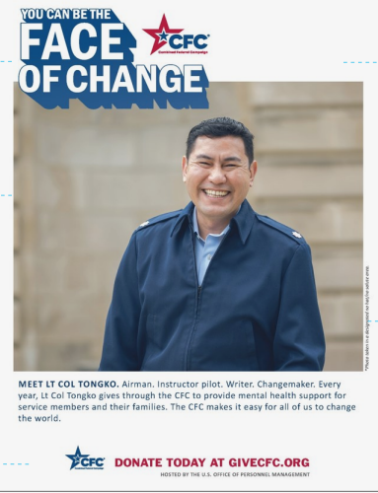
2022 CFC THEME
You can be the face of change.
Notes:
We will be bringing back the "You can be the face of change” theme for the 2022 campaign. It uses storytelling profiles and compelling photos of real federal employees like yourselves to invite your colleagues to join the CFC community and change the world together!
What’s great about the theme and materials is that it really personalizes the campaign. As campaign workers, not only are you changemakers yourselves, but you will be inviting your co-workers to join you in pledging through the CFC.​ We all have causes we care about, and we invite you to tell your own story to get people thinking about why they give.

Slide 7
Campaign roles
Local Federal Coordinating Committee (LFCC)
  Serves as board of directors in each of the 36 local CFC zones.
Outreach Coordinator (OC)
  Government contracting agency selected to support outreach and marketing efforts within each zone
Loaned Executive (LE)
Senior federal employee “loaned” to support CFC activities in a local zone
Campaign Manager/Coordinator
  Manages CFC efforts in each agency/ installation. Leads Keyworkers, hosts events, and publicizes the campaign.
Within an agency or military installation
Keyworker
  Supports the campaign by personally inviting all colleagues to give through the CFC.
Office of Personnel Management (OPM)
OPM's Office of CFC Operations oversees the entire CFC program.
Central Campaign Administrator (CCA)
Maintains the national CFC online giving system, receives pledges, and distributes
funds to charities.
(The CCA can be contacted at: 800-797-0098, 608-237-4898, or cfcgiving.opm.gov/contact.)
Notes:
Let's take a minute to discuss the roles within and agency/office or military installation/unit. Here is the structure of federal employee CFC roles:
LFCC: Each of the 36 local CFC zones is governed by a Local Federal Coordinating Committee (LFCC), which serves as a board of directors for the campaign zone comprising of Federal employees
Outreach Coordinator:
Some Zones have assigned Loaned Executives: A federal campaign assistant “loaned” to work for the CFC for a specified length of time (as determined by the LFCC and the LE’s federal agency) to support campaign activities.
This is the section that is probably most important to you – what happens within your agency or military installation:
Campaign Manager/Coordinator: Develops a plan to communicate about the CFC to all employees, recruits a planning committee, coordinates with unit leaders to identify Keyworkers, facilitates Keyworker training, and supports the implementation of all planned events.
Keyworkers: Are the boots on the ground. A federal employee who supports the campaign by personally inviting colleagues to give through the CFC by making a monetary gift and/or pledging volunteer hours.
And here are a few more CFC-related terms you will hear:
Central Campaign Administrator (CCA)
Maintains the national CFC online giving system, receives pledges, and distributes funds to charities.
(The CCA can be contacted at: 800-797-0098 (toll-free), 608-237-4898 (local/international), or cfcgiving.opm.gov/contact.)

Slide 8

YOUR #1 TASK
    Your #1 task as a campaign worker is to invite all of your colleagues to give through the CFC.
Notes:
As a campaign worker, whether you are a campaign manager or a keyworker, but especially keyworkers, you will inspire your colleagues by sharing the impact of the CFC. Your #1 task is to invite all of your colleagues to give through the CFC. It really is that simple. This is a voluntary campaign, so whether someone chooses to give and how much they choose to give and which charities they choose to support are very personal decisions. All you have to do is make sure they know about the CFC, know why the CFC is important, know how to give, and have been invited to participate.
This entire training will be geared towards helping you accomplish this task. You can also reference the Campaign Worker Training Guide for more information, if you have not already done so. This is on our website.
We will also be going over additional ways to manage a successful campaign, including how to promote the campaign, host a CFC event, ways to give, submitting paper pledges and campaign closeout.

Slide 9
How do Campaign Workers support this?
Present the CFC briefing
Send weekly emails
Talk about the CFC
Answer questions
Thank your co-workers
Don’t forget to keep your leadership informed about the CFC!
Notes:
As mentioned, your #1 task is to invite all of your colleagues to give through the CFC, the way you can support this task is to;
Present the CFC briefing slides in a meeting. These can be found on our website, that we will be showing you near the end of this presentation.
Send weekly emails that can be found in the Campaign Worker Toolkit.
Talk about the CFC with your colleagues and answer any questions that they may have about the CFC including, how and where to give.
And last but not least, ALWAYS thank you colleagues for their time and consideration of donating through the CFC.
Of course, don’t forget to keep your leadership informed about the CFC during the entire duration of the campaign.

Slide 10
CAMPAIGN MANAGER
Develop Campaign Plan
Recruit Campaign Team
Motivate Campaign Team
Engage Leadership
Share Results
Notes:
(Use the “Campaign Management” section to train Campaign Managers on managing Keyworkers and the campaign.. Slides 10-14.)
If you are a Campaign Manager, it is your job to recruit and motivate Keyworkers so that all of your colleagues can be invited to give through the CFC. You will also be responsible for sharing the campaign progress and results with your leadership and team. I know we have keyworkers on here but some of you maybe taking on the role of both keyworker and campaign manager for your agency/unit.

Slide 11
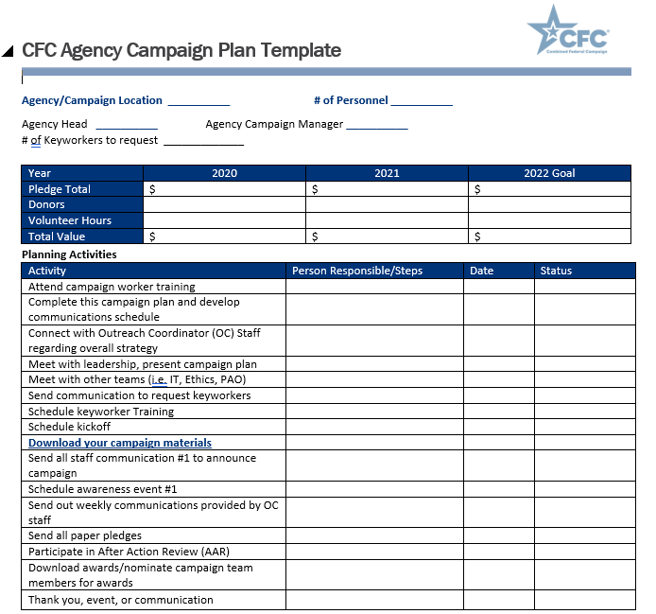
DEVELOP CAMPAIGN PLAN
Notes:
The first part of implementing a campaign, is planning for it. Your CFC point of contact should have provided you with this document to complete. It will help you to think through and plan out the many different critical steps in planning a campaign such as a goal, events, your campaign team, and collecting, accounting for, and sending in paper pledges. Once you have completed your Agency Campaign Plan, please share it with you’re CFC Point of Contact.
Let’s talk about some of these items in detail beginning with recruitment. If you are at a large agency or office, you will need some help. If you are at a small agency or office, you may serve as the campaign manager, but still complete key worker duties. If so, you won’t have to worry about recruitment. But for those of you that do:

Slide 12
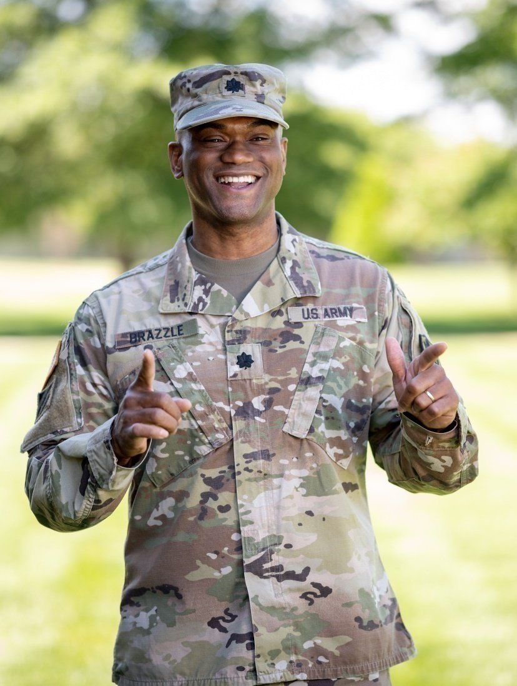
Recruit
Building a strong team is vital to the campaign’s success.
Ask leadership to assist in recruiting Keyworkers (reference the Leadership Section of the Campaign Worker toolkit for an email template)
Don’t forget to include other support members like: IT, Ethics, Communications, and Public Affairs
The CFC needs you!
Notes:
Building a strong team to help you implement the CFC in your agency/installation is vital to the campaign’s success. Keyworkers and other support members will plan and implement critical elements of your campaign, including implementation, communications, logistics, marketing, and event planning. Think about recruiting both newer employees as well as more experienced employees. If possible, include next year’s Campaign Manager on your committee.
Ask leadership to assist in recruiting Keyworkers, by sending an official request/memo/tasker to ensure the task is distributed to all managers/supervisors. Reference the Leadership Section of the Campaign Worker toolkit for an email template.
Additional support for your campaign committee:
Information Technology: Provides technical support and addresses issues such as firewall blocking.
Ethics Office: Assists with necessary approvals for processes and events.
Communications Team: Distributes information about the campaign, including memos, announcements, articles, and events.
Public Affairs: Promotes events and can help document the campaign with photos/videos.
Internal Team: Submits paper pledges and tracks results.

Slide 13

Motivate
Host regular meetings with campaign team to:
  Train
  Offer motivation
  Share results
  Answer questions
  Review procedures
  Share best practices
Notes:
Once you have a team, you will need to keep motivation high and participation strong.
Train your team: EVERYONE should be trained.
CFC staff are offering over 40 of these training sessions. As your team gets assigned, send them the registration link you used to sign up for this session. They can register for any of our remaining sessions. Please ensure that your entire team is trained.
Offer motivation by hosting weekly check-in meetings with Keyworkers to share progress, answer questions, review procedures, and share best practices. These meetings can also be used to plan upcoming events or activities like Giving Tuesday and Finish Strong.
To help Keyworkers stay on track, provide a weekly goal for a number of contacts, and ask them to track their progress and report back.

Slide 14
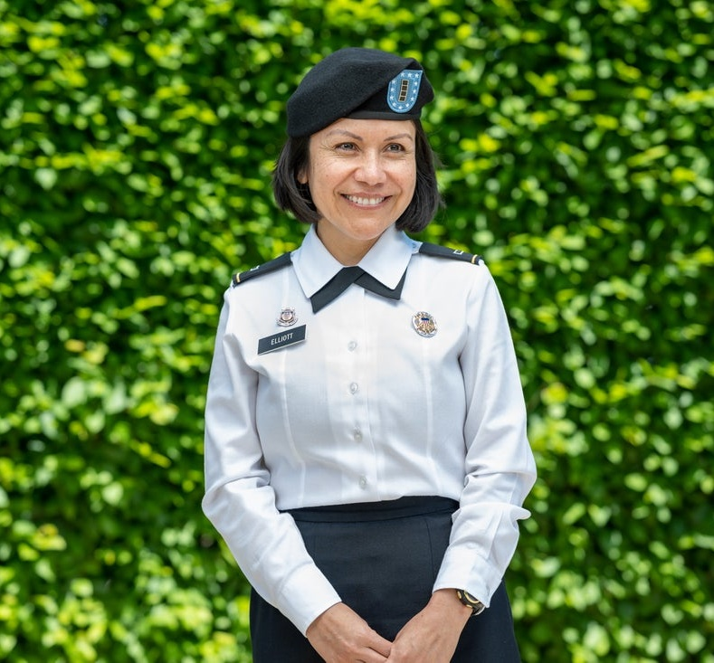
ENGAGE leadership
Examples of visible/tangible leadership support:
Help recruit Keyworkers
Public CFC endorsements
Set CFC goal
Attend campaign events
Make a public pledge
Offer incentives/perks
Recognition
Notes:
Leadership support is one of the key elements of a successful campaign. Think about ways your agency/installation leadership could help you promote the campaign. While the CFC does not allow coercion, (like: leaders can’t directly ask subordinates to pledge, set 100% participation goals, or set a per-person giving amount) they CAN and SHOULD provide general visible and tangible support for the CFC. Make sure to brief leadership and share results on progress throughout the campaign to continue support.
Here are some great examples of things you can ask your leaders to do:
Help to recruit Keyworkers
Publicly endorse the CFC
Set CFC goals
Attend campaign events
Make a publicly pledge (this can also be a photo opportunity)
Offer incentives/perks like parking spots, time off, lunch with leadership – as allowed by your agency's ethics office
Recognize campaign workers verbally and/or through memos, emails, certificates
Reference the Leadership section of the Campaign Worker Toolkit, with resources such as ready to use communication, tips and much more, which is available on our website.

Slide 15

Share results
Brief leadership and Keyworkers weekly:
Celebrate campaign progress toward goal
Use the weekly pledge reports provided by the CFC
Notes:
Brief leadership and campaign workers on the weekly campaign progress, share upcoming events, and review ways for them to get involved.
Keep Leadership and Keyworkers informed of campaign progress​ and celebrate the progress towards the goal. You can do this with a barometer showing the progress each week. These ae on our website for you to download.
We will be providing you with weekly reports of your agencies’ pledges. Please share these with your leadership.

Slide 16
KEYWORKER
Promote The Campaign
Plan and Host CFC Events
Educate On Ways To Give
Submit Pledges
Notes:
You know that your #1 goal as a campaign worker is to make sure all of your colleagues have been invited to give through the CFC. And we have talked about campaign manager responsibilities to make that happen. But did you know that people need to hear about something 4-6 times before they take action? As Keyworkers (and campaign managers) here are some additional tasks that will enrich your efforts.

Slide 17
Promote the campaign....
IN PERSON
Virtually
  Print and hang posters and banners
  Track progress with barometer poster
  Place donor cards on desks/ high-traffic areas
  Use splash screen on digital signage
  Place CFC articles and ads in publications
  Develop a CFC section on your intranet
  Promote splash screens
  Engage with the CFC's social media
  Send weekly emails and newsletters
Include Public Affairs and your community support centers to help publicize the campaign!
Notes:
First, make sure your co-workers know it is CFC season by promoting the campaign EVERYWHERE you can!
If you are a veteran campaign worker, you might remember receiving printed materials to help promote the campaign. This year, all resources are available in digital format in easy to download, printable files. There will be no printed materials we are urging you to print your own materials.
Here are a few ways you can increase public visibility within your IN-PERSON campaign (if applicable).
Print and hang campaign posters and banners in prominent areas, these will be posted on all zone websites in printable files.
Track campaign progress with a physical barometer poster.
Print and place donor cards and flyers on people's desks or in high-traffic areas.
Use splash screen on digital signage and public monitors.
Coordinate with your Public Affairs Office to place CFC articles and ads in publications.
Here are a few ways you can increase public visibility within your VIRTUAL campaign.
Develop a CFC section on your intranet highlighting the benefits of giving, inspiring stories, photos of campaign activities, and progress toward campaign goals.
Promote splash screens on everyone’s computer when they log in for the day.
Engage with the CFC's social media accounts by liking, commenting, and sharing.
Send out the pre-drafted weekly emails from the Campaign Worker Toolkit.
One of my agencies is NASA. As well as using their internal resources, they have an all staff CFC Microsoft Teams page where employees can go in and give their comments or share pictures of their CFC Cause. If they volunteer, they can add their pictures.

Slide 18
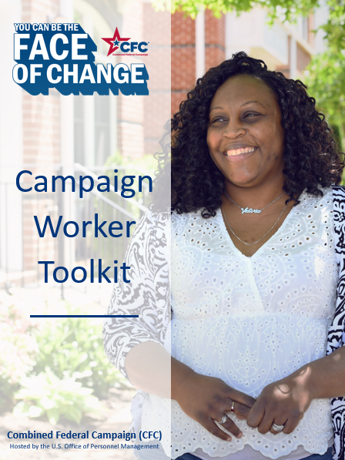
CAMPAIGN WORKER TOOLKIT
Start Strong
Cause Week
Giving Tuesday
Leadership
Events
Finish Strong
Thank You
Notes:
This years Campaign Worker Toolkit will be your go-to guide to help promote the different phases of the campaign. This toolkit has ready-to-use communications, emails, social media content, and graphics, as well as other ways to promote the campaign like activities, splash screens, banners, videos, press releases, and more! It walks you through the campaign week by week.
Kick off your first week with Start Strong, promote the different causes through the Cause Weeks, celebrate the largest online giving day of the year with Giving Tuesday, utilize the provided Leadership resources to engage your leadership, host amazing campaign events with the Events section, push the campaign to a successful conclusion with the Finish Strong, and then use the Thank You section to thank your colleagues for their time and support at the accumulation of the campaign.

Slide 19

2022 Cause of the Week
Education (Week of Sept. 19)
Global Health (Week of Sept. 26)
Housing & Shelter (Week of Oct. 3)
Disaster & Crisis Response (Week of Oct. 10)
End Poverty (Week of Oct. 17)
Arts & Humanities (Week of Oct. 24)
Animal Welfare (Week of Oct. 31)
Military & Veterans Services (Week of Nov. 7)
Children & Family Support (Week of Nov. 14)
Food & Nutrition (Week of Nov. 21)
Giving Tuesday Week (Week of Nov. 28)
Human Rights (Week of Dec. 5)
Environmental Protection (Week of Dec. 12)
Mental Wellness (Week of Dec. 19)
Community Improvement (Week of Dec. 26)
Medical Research (Week of Jan. 2)
Finish Strong Week and Choose Your Cause (Week of Jan. 9)
Notes:
The easiest and most effective way to promote the campaign from start to finish is to highlight each cause of the week. The Cause of the Week section of the Campaign Worker Toolkit, mentioned on the previous slide, has a section for each week with resources to promote each cause in your agency/installation. This includes, weekly email templates, dollar statements, stories, social media content, etc. Reference the Cause of the Week section of the Campaign Worker toolkit for more ways to incorporate causes in your events.
A Virtual Tip: Consider doing a weekly virtual “Lunch & Learn” where you invite a charity or charities within that week’s cause area to chat about their mission and the impact of the CFC.

Slide 20
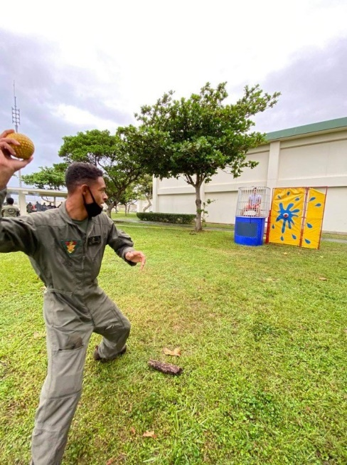
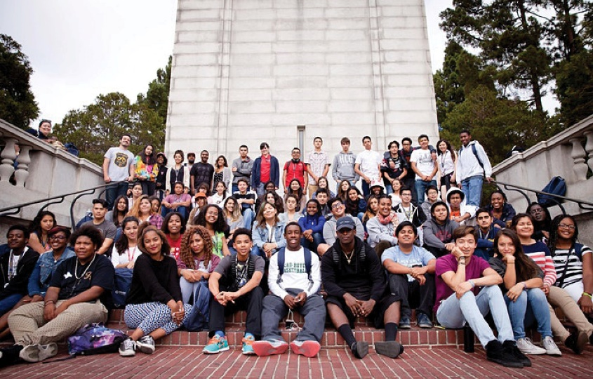
Host A CFC event that…
Promotes employee engagement (including remote workers)
Educates about CFC charities​
Increases participation
Motivates campaign workers
Increases donations
Takes place during duty hours
Boosts morale
Remains voluntary and within ethical and safety guidelines
Available Resources: Events Guide, Event Videos and Stories, Event Section in the Toolkit
Notes:
Another way to help publicize the campaign is by hosting a local CFC event. We would love to see each agency/military installation host at least one CFC event this year. Well executed events, either on-site or virtual, can be powerful tools to;
Give colleagues the opportunity to hear directly from the charities they support.​
Increase participation in the campaign.​
Give employees opportunities to learn about the CFC.​
Motivate campaign workers.​
Increase donations for charities.​
Make you (the organizer) look like a rock star to your leadership.​
Boost morale in your workplace.​
Now, more than ever, reaching remote or telework employees is essential in hosting an event.
Plus, events are FUN! Don’t forget to incorporate charities into your event—they are the heart of the CFC, and their stories can motivate your colleagues to donate!
To pull off a successful campaign event, you will need to consider several things.
Give yourself plenty of time! Planning at least two weeks in advance will help secure charities for your event, get on your leadership’s calendar, reserve a location, and will give ample time to promote your event to maximize attendance and impact. ​
​
Promote the event through announcements, flyers, emails, newsletters, splash screens, social media, website, intranet, bulletin boards, and word of mouth. Contact your local public affairs office or radio station for event coverage. ​
One of my Agencies had their in-person events such as a Chili Cook Off, Jail the Manager and a MUSIC night. When COVID hit they knew they had to get more creative, so these platforms were also a viable way to add their remote successful event of Pets, Pumpkins and Peewees. The staff send in their pictures and leadership chooses winner from each category. Another event they incorporated was a wellness day where they had a 30 minute workout, that all employees could join from their computer. These type of events can be incorporated with little effort whether you are in the office or working remotely to promote the CFC.

Slide 21
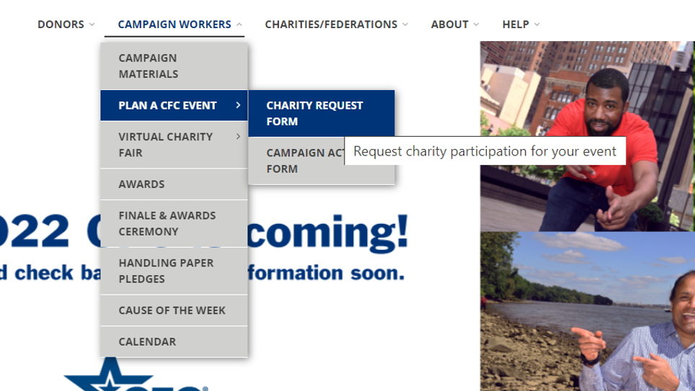
EVENTS...HOW TO REQUEST CHARITIES
Notes:
​Including charities and charity speakers in your event shows your co-workers what kinds of charitable causes they can support through the CFC. You can request charities to participate in your event by using the "Charity Request Form" on the website. This can be found under the "Campaign Worker" menu as a part of the "Plan a CFC Event" page.
Here are a few things to remember when requesting charities to participate in your event:
It takes time to work with the charities and confirm their attendance. So please submit your request early. 14 days before you event is perfect.
To be fair and equitable to all the CFC charities, we use a random method to invite charities to participate in campaign events. This provides all charities with the opportunity to participate and not the same charities coming to your events.
Be sure to register the event to show in the mobile CFC giving app. There are directions of how to use it under Campaign Workers on the website. This is easy to use and convenient. You download the app, it is linked to your account and if you have not registered you can create an account, search for charities, Give by tapping each charity you want to support and entering the dollar amount and complete your donation. Federal workers can also pledge volunteer hours

Slide 22

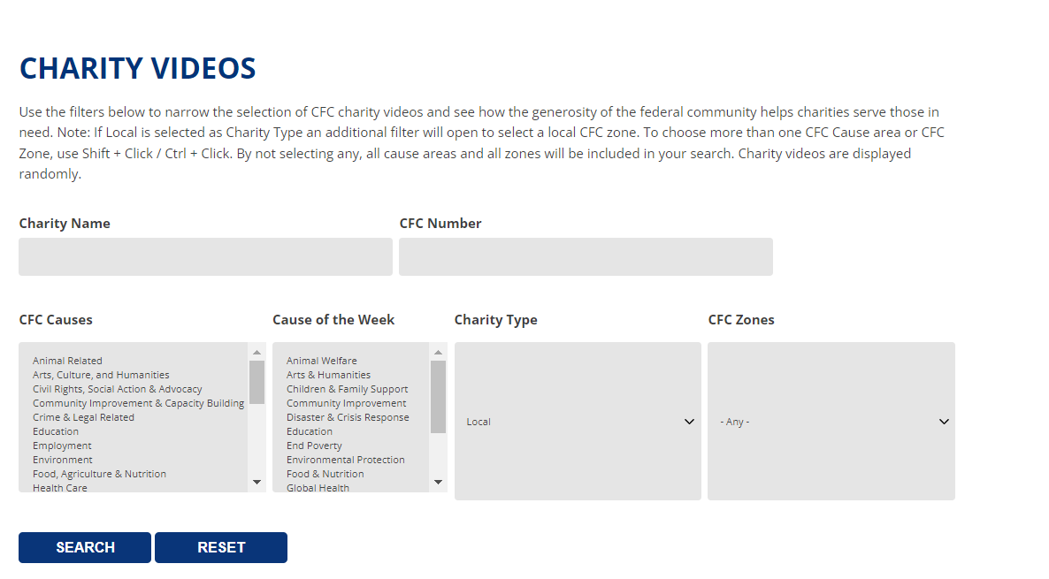
VIRTUAL CHARITY FAIR
Notes:
Use the Virtual Charity Fair to showcase different videos and stories from CFC charities. Kick off your next staff zoom or team meeting with a charity video or story! Or consider hosting a Virtual Charity Fair event where participants can see different charity videos/stories. OR feature different videos and stories in the Lunch-N-Learn sessions, following the cause of the week calendar.
To navigate this VCF you will use the filters below to narrow the selection of CFC charity videos by taxonomy codes, Cause of the Week, Charity Name, CFC number, or charity type. If “Local” is selected as Charity Type an additional filter will open to select a local CFC zone. To choose more than one CFC Cause area or CFC Zone, use Shift + Click / Ctrl + Click.
By not selecting any, all cause areas and all zones will be included in your search. Please note: Charity videos and stories are displayed randomly.
Now that we’ve covered how to plan and implement your campaign, let’s talk about what happens when we approach the end.

Slide 23
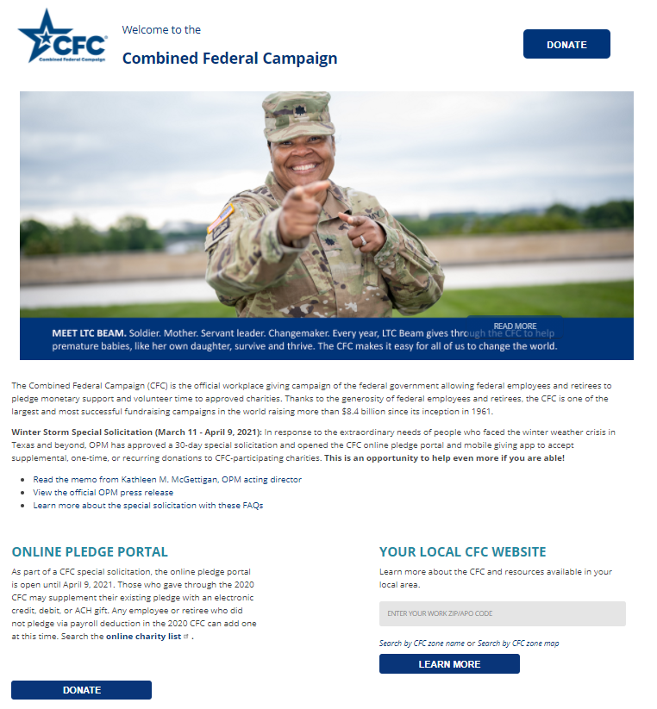

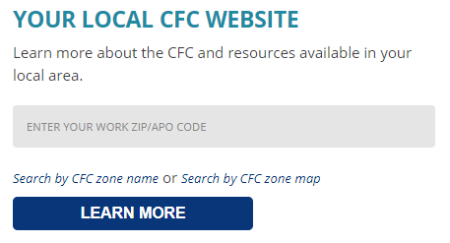
Website GiveCFC.org
Notes:
The CFC has all the digital resources you need for a successful campaign, but where can you find them?
All digital resources are available on your local website, that can be found at GiveCFC.org.
This is the GiveCFC.org central landing page. You will be able to find our local zone content by entering your ZIP code or clicking on the zone name or zone location from the map on the homepage. This page allows all visitors to connect to their local zone, engage with the CFC by donating, or participating in an expanded digital experience.
[If possible, connect to the website to show the engagement activities available on the landing page.]

Slide 24
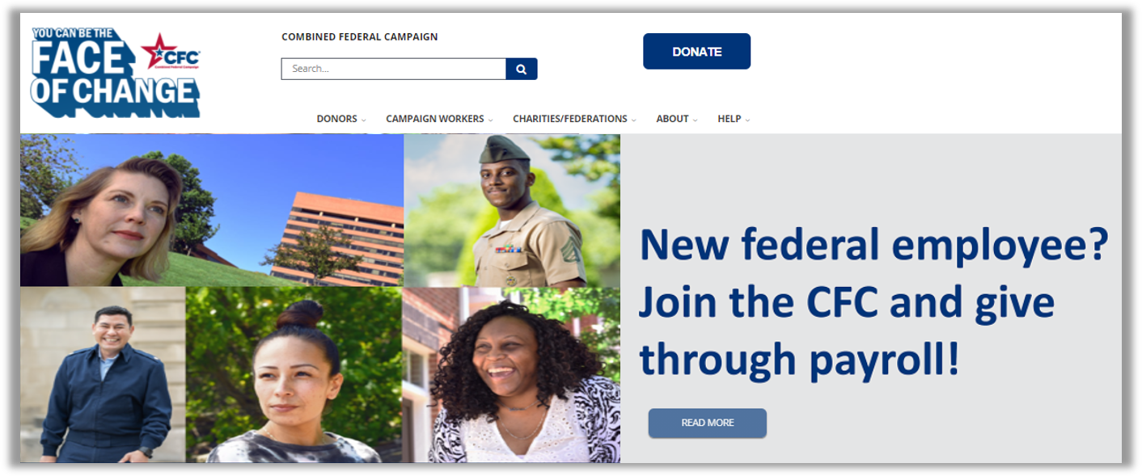
Website local zone
Notes:
Once you locate your local zone website, it will be similar to this. As a Campaign Worker, we encourage you to bookmark the URL of this local zone CFC page as a favorite on your browser so you can go straight to it in the future.
From the local zone website, you can access all of the campaign materials and resources we are talking about today. You can find these by navigating to the “Campaign Worker” drop-down menu at the top of the page, click “Campaign Materials” to be directed to the campaign materials and resources page. From here you can from the various categories of promotional materials, training materials, Campaign Worker toolkit and more.

Slide 25




WAYS TO GIVE
Online Giving
Paper Pledge Form
CFC Giving
Mobile App
Federal employees can also donate volunteer hours!
Notes:
Now that we've shared the way to promote the CFC and invite. Let's take a deep dive into the giving options and systems to be sure your toolbelt is fully equipped when questions come.
In the next few slides, we will be walking through these different giving options, starting with Online donations.

Slide 26
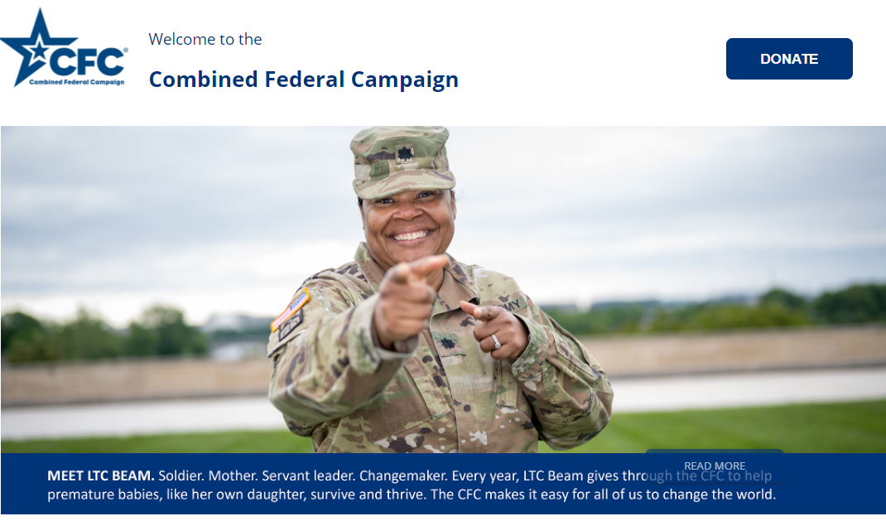
ONLINE DONATIONS
STEP 1: CLICK DONATE AT GIVECFC.ORG.
Notes:
When donation online:
Step 1: The first step is to click DONATE on GiveCFC.org or on your local zone webpage.

Slide 27
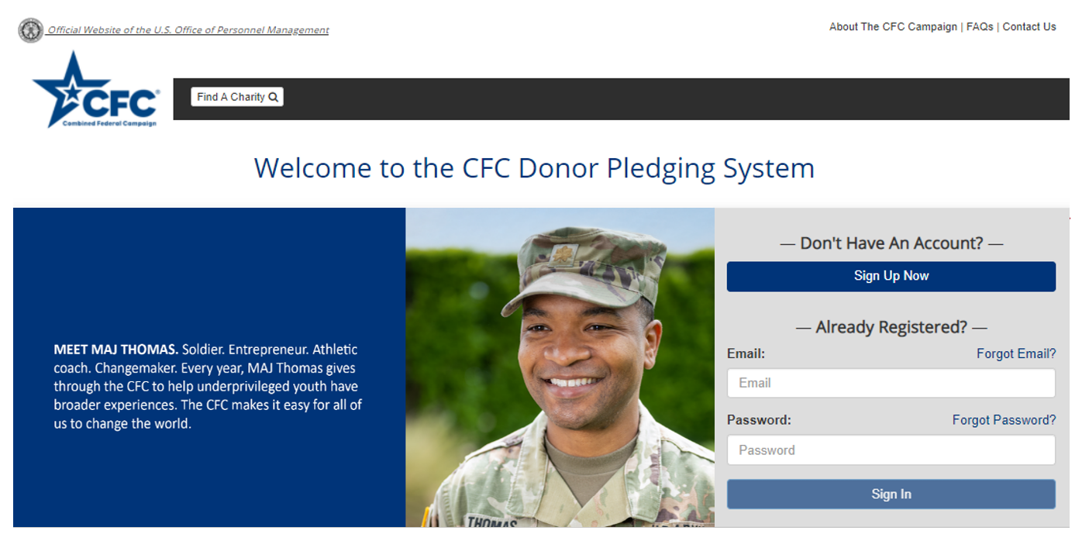
Step 2: CREATE AN ACCOUNT or
LOG IN to your existing account.
New Users:
Click “Sign Up Now”
Returning Donors:
Click “Sign In”
Notes:
Step 2: Create an account or log in to your existing account.

Slide 28
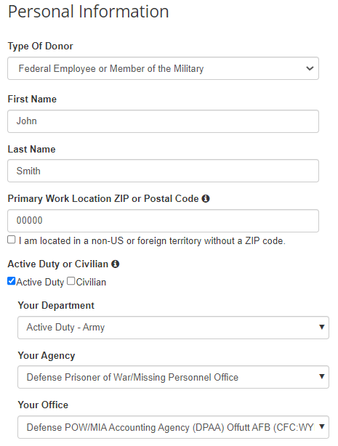
Step 3: COMPLETE or UPDATE your profile.
a. Enter the ZIP code of your office to access the correct list of units/offices.
Our office ZIP code is:______
b. Enter your CFC unit code to automatically populate the Department/Agency/Office selections.
Our CFC unit code is:______
*If you can't find your D/A/O, contact your Campaign Manager or local CFC office for assistance.
Notes:
Step 3: Complete or update your profile:
Most of this is self-explanatory, name, contact info, etc. But there are two critical pieces of information you need to educate your colleagues on: your work ZIP code and your CFC unit code.
Together, those ensure your unit gets credit for the donation when the reports start coming out.
Contact your Campaign Manager or local CFC office if you do not know your local CFC unit code.
Special note: CFC-Overseas (not in Hawaii or Guam) should use their APO/FPO zip code. Those in Guam, California, or at a CONUS based Navy ship should NOT use their APO/FPO and instead use your local shore side zip code.
[Make sure to pause here, go over finding unit codes, or ask if there are any questions, as this page is very important.]
After this training please go onto the website and make sure you know your department, Agency, Office. This is how we track your donations. When you find it you want to note your unit code so you have it on hand.

Slide 29
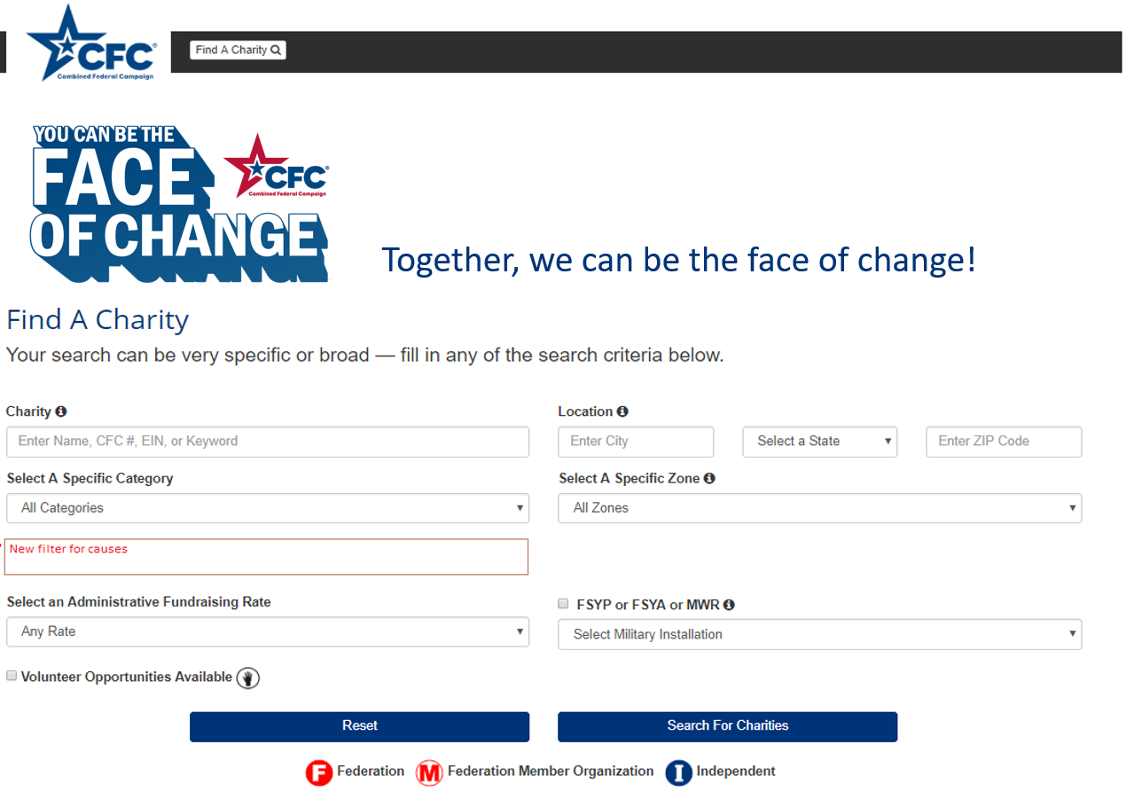
Step 4: Search for CHARITIES you want to support.
Search by:
Charity
Location
Select a Category
Zone
Cause
Administrative Fundraising Rate
FSYP, FSYA, or MWR
Volunteer opportunities
Notes:
Step 4: Search for charities you want to support. You can search by charity name, location, cause area, volunteer hours accepted etc.… This really helps narrow down the list of the more than 5,000 approved CFC charities! Then you can just click on charities and add them to your basket. Here you will see any charities that have selected to accept volunteer pledge hours, this will be represented by a hand icon, you can also filter the search by charities accepting volunteer hours.

Slide 30
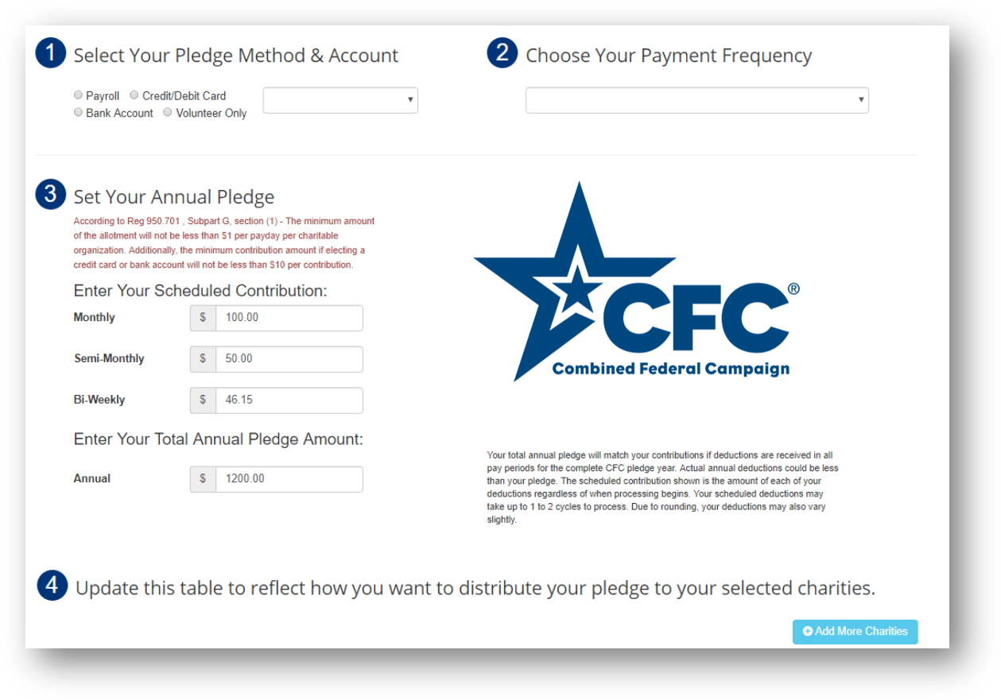
Step 5: Make your PLEDGE.
Notes:
Step 5: Make your pledge and choose your pledge method (payroll deduction, credit/debit card, or bank transfer). Chose you payment frequency (one time or recurring), if applicable. Select the annual pledge amount. Then you can allocate your donation and volunteer hours to the charities you selected.
When giving online you can give through:
Payroll Deduction – min donation is $1 per check (military is $12 annually/DoD Civ is $24 annually). And (Other Civil servants $26 annually)
Credit/Debit Card – min. donation is a $10 per transaction
E-check/Bank Transfer
Donate Volunteer Hours – 1 hour min volunteer

Slide 31
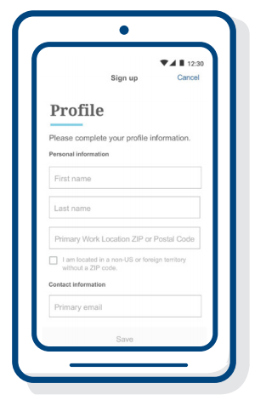
CFC Giving Mobile App
How to Use It:
Download the App
Sign in or create an account
Search for charities
Give
Complete your donation
Check it out!
Create an account or edit an existing profile
Pledge via payroll deduction
Pledge volunteer hours
Release contact info to charities
Make multiple pledges
Notes:
The CFC Giving Mobile App was primarily designed to take the place of onetime cash donations at CFC events, but it has been expanded to offer more options for donors. Then, attendees can find the event in the app and easily make a onetime donation to one or more of the participating charities (or they can search the entire charity list and give to any CFC-approved charity).
CFC Giving Mobile App users will be able to give through:
Payroll Deduction
Credit/Debit Card
E-check/Bank Transfer
Donate Volunteer Hours
For more information get together with your Program Manager.

Slide 32

DONATE BY TEXT
Two links will be sent to mobile device:
1. Link for donors that want to make a one-time donation by PayPal or Credit Card
2. Direct link to the CFC mobile Giving App for one-time ACH or credit card donations, reoccurring payroll pledges, and commitments of volunteer time.
Text “DONATE” to
978-487-5678.

Slide 33
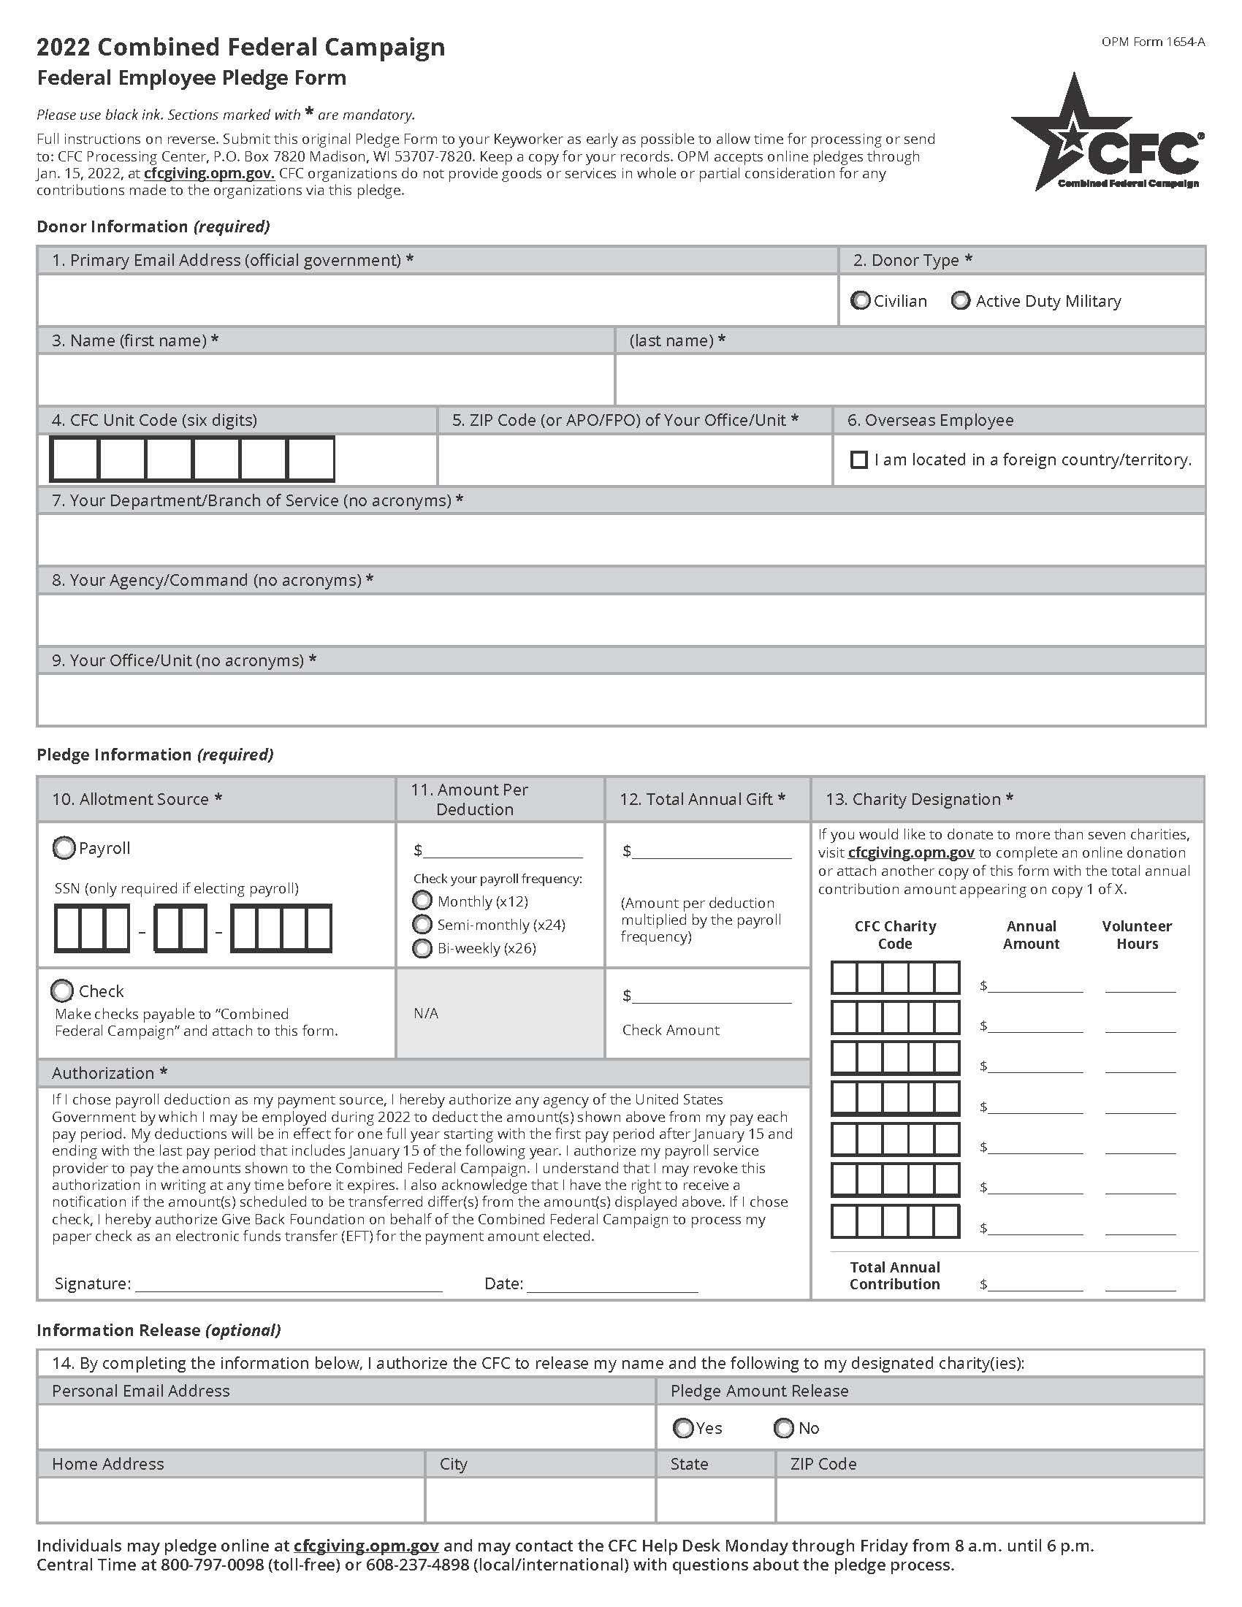
Paper PLEDGE Form
Make sure all required fields are completed and doublecheck:
A. CFC unit code and the ZIP code for your unit/office are correct
B. Reporting unit information is filled in and correct
C. Social Security number is provided for a payroll deduction pledge
D. Total gift and charity designation amounts should match
E. Funds must be designated using a 5-digit charity code
F. Authorization is signed
G. Optional section – if left blank, donor is giving anonymously
A
B
D
E
C
F
G
Notes:
We are not printing this year.
When donors are using paper pledge forms, they should be reviewed for legibility, details, and calculation of the charity allocations. If you discover any errors, work with the donor to correct them before submitting to the Processing Center. Pledge forms missing required information will experience processing delays and/or potentially will not be able to be processed. Please advise donors NOT to wait until the end of the campaign to turn in their pledge form.
Online there are three pledge forms. One is for USPS only, there is one for Retirees, and one for regular federal employees so make sure you print the correct one.
Make sure all required fields are completed and doublecheck:
CFC unit code and the ZIP code for your unit/office are correct.
Reporting unit information is filled in and correct.
Social Security number is provided for a payroll deduction pledge.
Total gift and charity designation amounts should match.
Funds must be designated using a 5-digit charity code.
Authorization portion is signed.
This section is optional. By leaving it blank, donors are giving anonymously to the charities they chose. By completing it, they are agreeing to release some of their personal information to their chosen charities.
Donors using the paper pledge form will be able to give through:
Payroll Deduction
Check
Donate Volunteer Hours

Slide 34
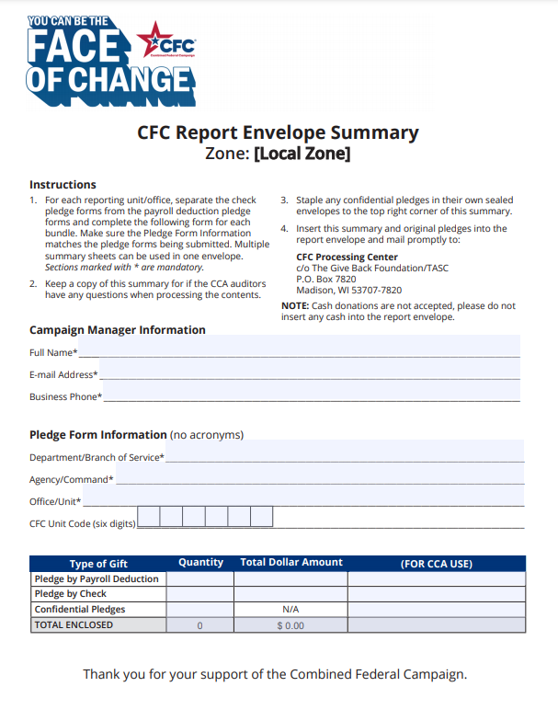
Submit PAPER pledges
To submit completed paper pledge forms:
Download and print Pledge Report Summary.
Complete the Pledge Report Summary form with pledges.
CFC Processing Center
P.O. Box 7820
Madison, WI 53707-7820
Notes:
*LAUNCH POLL BEFORE MOVING ONTO NEXT SLIDE*
After reviewing all pledge forms, you can submit completed paper pledge forms by, downloading and printing the CFC Pledge Report Summary form from the website. Then complete and enclose the Pledge Report Summary Form with the completed pledge forms, and mail to the CFC Processing Center
If you are in the office, you will need to think through this process.
Recommend to make a copy of the summary report for tracking and record purposes. So, you can keep a track for when you receive your pledge summaries.
Establish if you will have a turn in day/time with your Keyworkers or take them on an ad-hoc basis.
For both Keyworkers and Campaign Managers - Make sure to have a safe/secure place to store pledge forms until you are ready to mail them in. These have personal details.
Check with your leadership or their admin support on how you can pay for postage through official funds.
[This process may differ per zone/agency/installation.]
Alternatively, donors can mail their own pledge forms directly to the CFC processing center.

Slide 35
CAMPAIGN WORKER RESOURCES
Visit GiveCFC.org to find a wealth of resources and materials.
Notes:
As we are getting close to the end of today's presentation, I am sure you are still working on absorbing everything already provided to you. Rest assured this is not the only resource for you to achieve a successful year. We have a ton on resources for you.

Slide 36
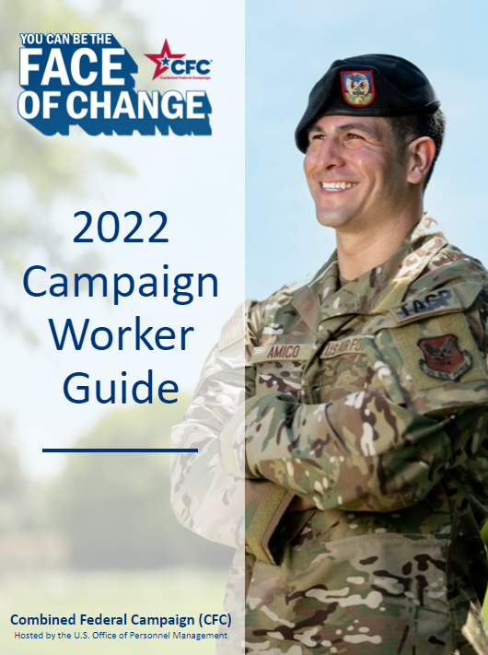
CAMPAIGN WORKER GUIDE
Notes:
This is the Campaign Worker Guide. Reference this guide for everything you need to successfully manage your campaign. Everything we covered today is also in this guide including an easy-to-follow checklist. Another go to resources is the Cause of the Week Toolkit talked about earlier

Slide 37
CAMPAIGN WORKER TOOLKIT
Start Strong
Cause Week
Giving Tuesday
Leadership
Events
Finish Strong
Thank You
Notes:
We went over this when talking about publicizing the campaign and wanted to reiterate how helpful this resource is. This years Campaign Worker Toolkit will be your go-to guide to help promote the different phases of the campaign.

Slide 38
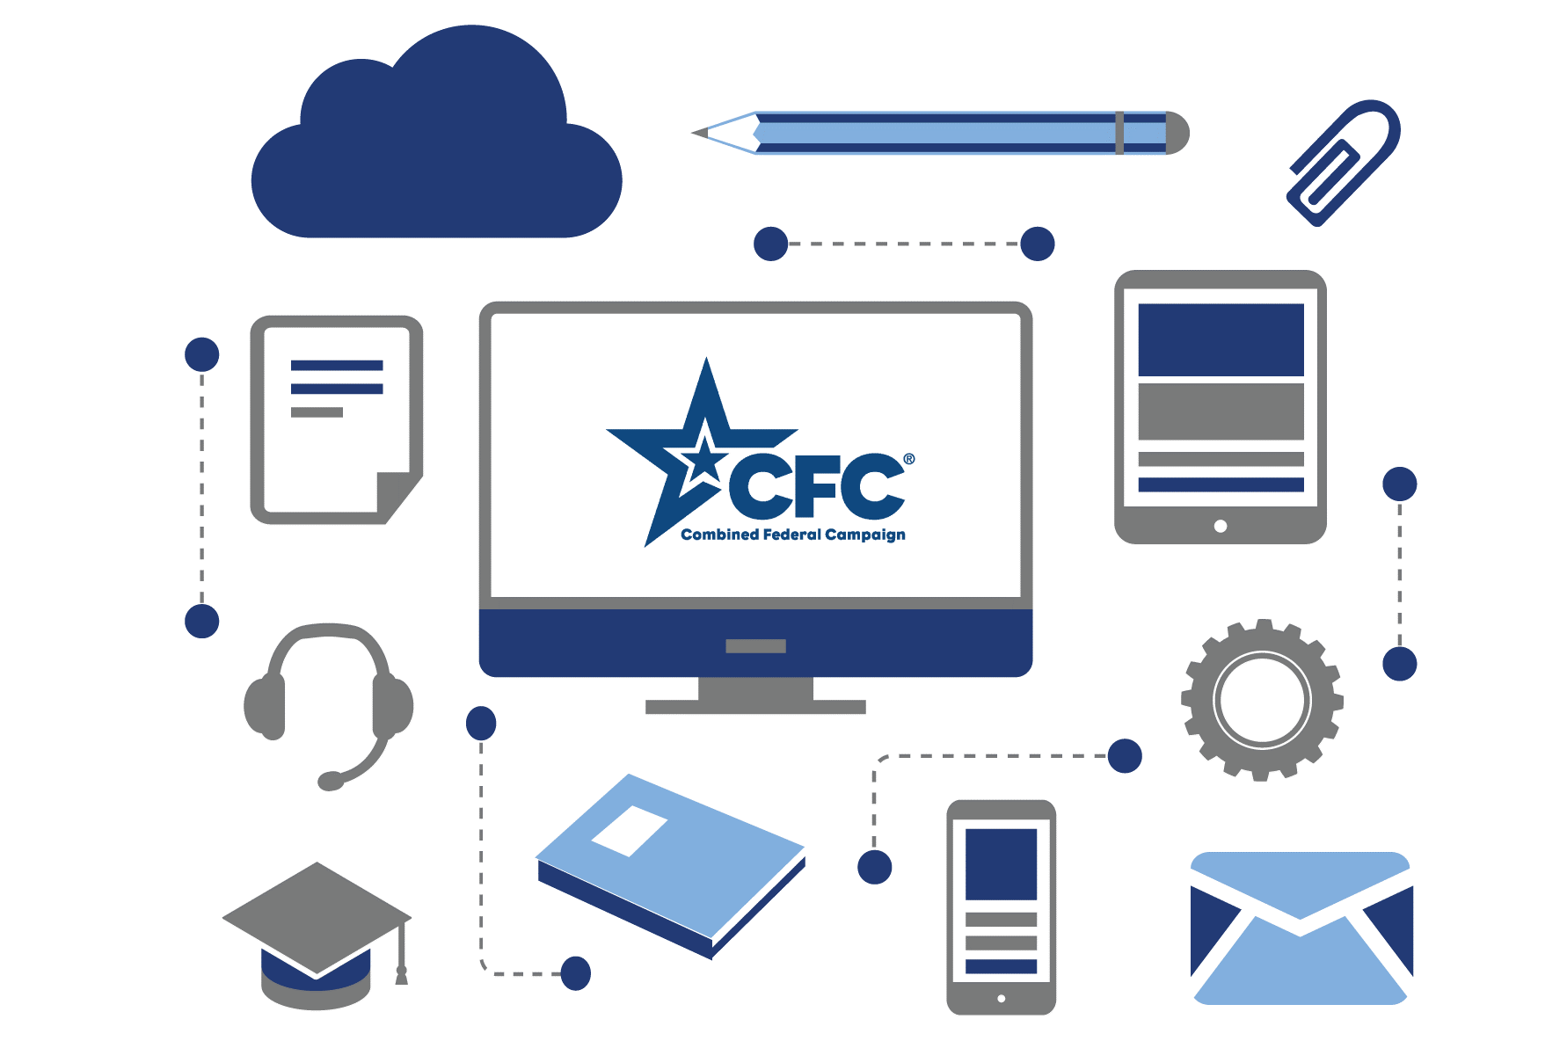
ONLINE TRAINING
Notes:
New for 2022, the CFC has developed a new online training tool. This training resource is a great supplement to this training and the guide to help you run a successful campaign. It is divided into modules, so you can watch everything from start to finish or jump straight to the section you want to review.

Slide 39

CFC BRIEFING
Delete the instruction slide.
Use the suggested script.
Practice giving the presentation.
Notes:
We have CFC Briefing slides. Location is in the Campaign Workers on our website to under emails and speeches.
These slides are easy to download and to introduce the CFC to your co-workers in a virtual or in-person meeting. The script has already been written for you in the notes section of the slides. So, all you have to do is download it, delete the first slide (with the instructions), practice a few times, and then you will be ready to present it!

Slide 40
CAMPAIGN
CLOSE OUT
Visit GiveCFC.org to find a wealth of resources and materials.
Notes:
We have saved the best for last, the Closing Out the Campaign, Thanking Everyone and celebrating your hard work and efforts!

Slide 41
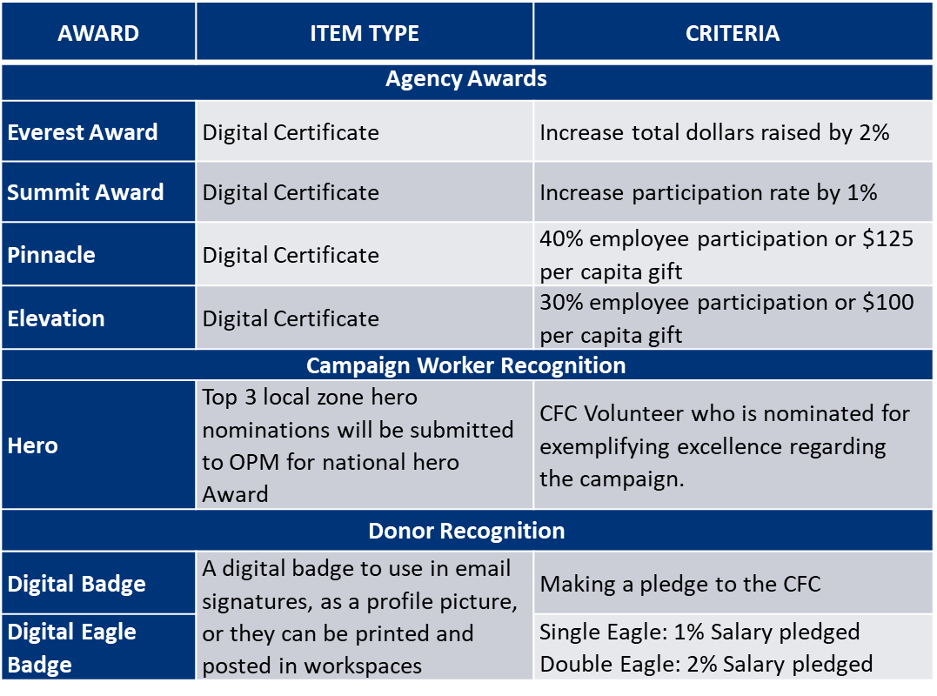
AWARDS PLAN
Notes:
A great way to recognize your team members and your agencies achievements is with Awards. This year’s Awards that can be earned at the department/agency level, at the office level, or the individual level. Use your weekly pledge reports to see if locations are earning the Everest, summit, pinnacle, or elevation award! Use that at motivation to keep the momentum up! Excellent campaign workers can be nominated for the hero award on your local CFC website, and donors can self identify and download their badges from the website!
You can also download Cause of the week badges.

Slide 42




Campaign closeout
Campaign Managers
Provide Recognition
  Thank your Keyworkers
  Plan and host an awards ceremony
  Provide certificates to Keyworkers
  Campaign Close Out
  Provide lessons learned
  Provide feedback
Keyworkers
Provide Recognition
  Thank EVERYONE
  Campaign Close Out
  Collect, review, and submit pledges
  Attend event ceremonies
  Provide feedback
Notes:
Some of the campaign’s most important activities take place after the campaign has ended. Recognition and appreciation helps to build morale and a strong foundation for your campaign, and for years to come. However, remembering to recognize your campaign workers throughout the duration of the campaign, is key in helping with the momentum of your campaign.
To closeout the campaign, Campaign Managers will;
Provide Recognition: How do they do this?
Thank your Keyworkers through a nice note or email.
Plan and host a CFC awards ceremony to thank participants, showcase your results, and recognize Keyworkers.
Recognize campaign workers for their service by providing a signed CFC certificate.
Close Out Activities:
Prepare a “lessons learned” report for future campaign Managers
Provide feedback, when asked, to help improve the campaign.
Keyworkers will;
Provide Recognition:
Thank everyone for their time and for considering a donation by sending the CFC Thank You card.
Close Out Activities:
Collect, review, and submit paper pledge forms.
Attend event ceremonies.
Provide feedback, when asked, to help improve the campaign.

Slide 43
Questions?
Notes:
Does anybody have any questions, or comments?
[Stop here to answer any questions.]

Slide 44
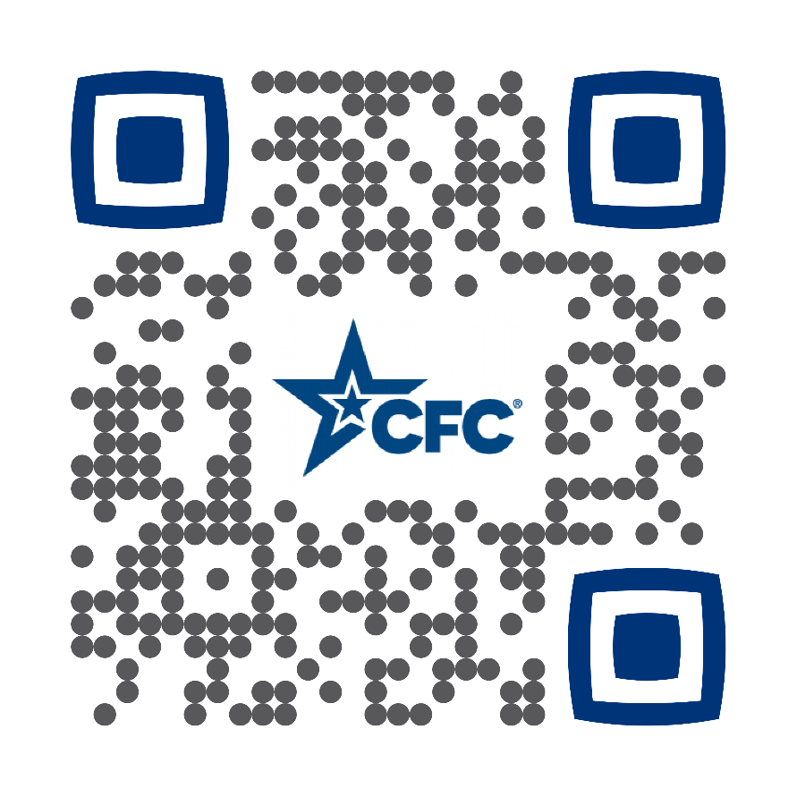



STAY IN TOUCH!
GiveCFC.org
cfcsupport@charity.org
888-638-4232
Notes:
[Stay in Touch slide- include contact info]
Thank you for serving as a Campaign Worker! Remember, your generous efforts as a campaign worker will have a huge impact on the CFC-participating charities and those they serve.
If you are unsure how to contact your Associate Program Manager you can either send a message to cfcsupport@charity.org if you do not know who they are or phone 888-638-4232 and press on their extension to leave a message.
Please complete the Feedback survey in the chat box.

